Slide 1
Provide context
VAGUE
Write some Python code.
SPECIFIC
Write a Python script that reads a CSV file and calculates the average value of a column named “sales”.
MOST SPECIFIC
Write a Python script that reads a CSV file named monthly_sales.csv from the /data folder, calculates the average value of the “sales” column, and outputs the result in JSON format. The script should handle missing values gracefully and include comments explaining each step. I’m integrating this into a Flask API, so make sure the function can be reused as part of an endpoint.
Notes:
VAGUE Write some Python code.
SPECIFIC Write a Python script that reads a CSV file and calculates the average value of a column named “sales”.
MOST SPECIFIC Write a Python script that reads a CSV file named monthly_sales.csv from the /data folder, calculates the average value of the “sales” column, and outputs the result in JSON format. The script should handle missing values gracefully and include comments explaining each step. I’m integrating this into a Flask API, so make sure the function can be reused as part of an endpoint

Slide 2
Offer examples
You are an expert software engineer writing high-quality unit tests. 🟥 BAD EXAMPLE (what to avoid): - Single trivial test with vague name and no edge cases.- No structure (no Arrange/Act/Assert), no table-driven tests, no negative cases. 🟩 GOOD EXAMPLE (what good looks like): - Clear Arrange/Act/Assert. - Descriptive test names that state behavior and intent.- Table-driven tests to cover multiple scenarios.- Include edge cases, invalid inputs, and boundary values.- Avoid unnecessary mocks; only mock external dependencies.- Prefer behavior checks over implementation details.- Optional: simple property checks where appropriate. ✅ RUBRIC (must pass): 1) At least 5 tests covering happy, edge, and negative cases. 2) Table-driven where feasible. 3) No brittle assertions that mirror implementation.4) Fast and deterministic; no network, time, or randomness without seeding.5) Lint/format compliant; idiomatic for the chosen framework.6) Provide brief comments explaining non-obvious cases.
Notes:
Few-shot prompting → you provide multiple examples (good and/or bad).
One-shot prompting → you provide a single example.
Also useful terms:
Contrastive prompting → show bad and good to highlight the difference.
Rubric-based prompting → include a checklist/acceptance criteria that defines “good”.
For unit tests, I recommend contrastive + rubric-based few-shot prompting: one bad example, one good example, plus a clear checklist.

Slide 3
Define role, style, or tone
Sharper Context → More Relevant Output
When you tell the AI “Act as a Senior Backend Engineer” or “Explain like a TDD mentor”, you give it a persona and perspective.
This influences depth, terminology, and focus—making the response aligned with your audience and goals.
Consistent Style & Structure
Specifying “Use concise, idiomatic Python” or “Follow Arrange-Act-Assert in tests” ensures the output matches coding standards and best practices.
Reduces time spent reformatting or rewriting AI-generated code.
Improved Accuracy & Completeness
Roles often imply domain knowledge:
A “Security Engineer” will include validation and threat considerations.
A “Performance Expert” will optimize for speed and memory.
This helps avoid generic answers and produce expert-level guidance.
Notes:
As a Principal Engineer performing a code review, analyze the following TypeScript function and propose three improvements focused on readability, testability, and performance. For each suggestion, include a brief rationale and a code snippet.

Slide 4
Break complex tasks into steps
Scenario: Refactor legacy code for testability (Java/Spring Boot)
NO STEPS
Refactor the user service to improve quality.
WITH STEPS
Refactor UserService in Spring Boot 3 for testability and maintainability. Steps:
Assess: Identify side‑effects (DB calls, HTTP requests, time, environment).
Isolate: Extract side‑effects behind interfaces; introduce dependency injection.
Refactor: Split long methods; remove static state; replace shared mutable state with immutable DTOs.
Tests: Add JUnit 5 Unit tests for pure logic; add slice tests for repository/controller; use Testcontainers only in integration scope.
Quality gates: Add CI with mvn test, code coverage, Checkstyle/SpotBugs.
Docs: Update README and class‑level Javadoc to clarify responsibilities and extension point.

Slide 5
Ground Responses in Source Material
Why it matters (for code): For large docs/repositories, first extract verbatim signatures, function contracts, and config keys, then write code only against those. This is the code analogue of “direct quotes.” Base reasoning only on retrieved content.
Prompt
From the provided FastAPI docs (./docs/api.md), extract EXACT endpoint paths, methods, request/response types, status codes, auth requirements. Output a JSON schema of these facts only. Then, and only then, generate a Python client that calls those endpoints, citing the JSON entries used.
Notes:
Ground Responses in Source Material
For tasks involving documentation or large codebases, instruct the model to:
Extract verbatim quotes or code snippets before analysis.
Base reasoning only on retrieved content.
Reference: Microsoft’s best practices for grounding outputs via Retrieval-Augmented Generation (RAG).
https://techcommunity.microsoft.com/blog/azure-ai-foundry-blog/best-practices-for-mitigating-hallucinations-in-large-language-models-llms/4403129

Slide 6
Verify with citations – executable verification
Why it matters (for code): Textual citations are useful, but in code the gold standard is compile + unit tests + runtime checks, optionally auto-generated and refined. Use both.
Cite the source for each claim or code snippet.
Prompt
Draft the function normalizeAddress(input) in Go. Then: (1) generate table-driven tests; (2) run them; (3) if any fail, repair and re-run until green. 3 Report the test summary and the final code only.
Notes:
Data-driven testing (DDT), also known as table-driven testing or parameterized testing, is a software testing technique that uses a table of data that directs test execution by encoding input, expected output and test-environment settings. 3. Verify with Citations
Require the model to:
Cite the source for each claim or code snippet.
Retract any claim that cannot be supported by retrieved evidence.
Reference: Transparency and citation-based trustworthiness strategies in recent ACL findings.
https://aclanthology.org/2025.findings-acl.919.pdf

Slide 7
Restrict External Knowledge
Why it matters (for code): For private codebases, restricting to retrieved repo/docs avoids invented APIs. But this can backfire if the retrieved context is insufficient, so add a “context sufficiency” check and allow abstention.
Cite the source for each claim or code snippet.
Prompt
Answer only using content retrieved from ./repo and ./docs. First, rate context sufficiency (sufficient/insufficient) for the task "add OAuth PKCE flow". If insufficient, return "insufficient context" and list missing files/sections.
Notes:
Explicitly instruct the model:
“Use only the provided context or documents; do not rely on general knowledge.” This prevents speculative code generation.
Reference: Grounded LLM frameworks and RAG-based workflows for factual consistency.
https://hogonext.com/how-to-build-grounded-llms-a-quick-guide/

Slide 8
Chain-of-Thought Verification
Why it matters (for code): Ask the model to show its reasoning step-by-step before producing final code. This exposes faulty logic early.
Cite the source for each claim or code snippet.
Prompt
Outline (max 5 bullets) the plan to refactor legacy Promise chains to async/await. Then apply the plan to src/legacy/*.js and run eslint/prettier + type-check. Show diffs that pass.
Notes:
Ask the model to show its reasoning step-by-step before producing final code. This exposes faulty logic early.
Reference: Chain-of-Thought prompting improves reasoning reliability and reduces hallucinations in production systems.
https://galileo.ai/blog/chain-of-thought-prompting-techniques

Slide 9
Avoid invented or malicious dependencies
Why it matters (for code): LLMs can invent library names or pick unsafe packages. Enforce allow‑lists and verify package existence and versions before generation.
Prompt
When suggesting imports, use ONLY packages from allowlist.json. Verify existence and latest safe version on the official registry. If a package is not allowed or cannot be verified, STOP and propose an alternative from the allow-list.

Slide 10
Meta‑prompt to craft a better coding prompt
Aks the AI to help you write a better prompt
Prompt
I want you to help me build the best possible prompt to achieve this goal: “Generate a production‑ready REST API in FastAPI (Python 3.11) with endpoints for CRUD over Product, including pagination, filtering, and JWT auth, plus PyTest tests and Dockerfile.” Ask any clarifying questions you need (framework versions, DB, error handling, performance SLAs, testing depth). Then propose a final prompt and a checklist the output should satisfy (style, tests, security, docs).
Notes:
This includes skill/agent/etc file.

Slide 11
Define Workflow / Pipeline Process
Build concrete workflows and instruct the agent to follow.
Implement System Design Doc -> Validate against other system docs for consistency
Implement System Design Spec -> Validate spec adheres to design doc
Implement Runtime -> Validate runtime adheres to the system spec
Perform End to End validation
Prompt
Implement the order notification component following the process outlined in system_workflow.md, ensure that all validation steps and agents are executed.

Slide 12

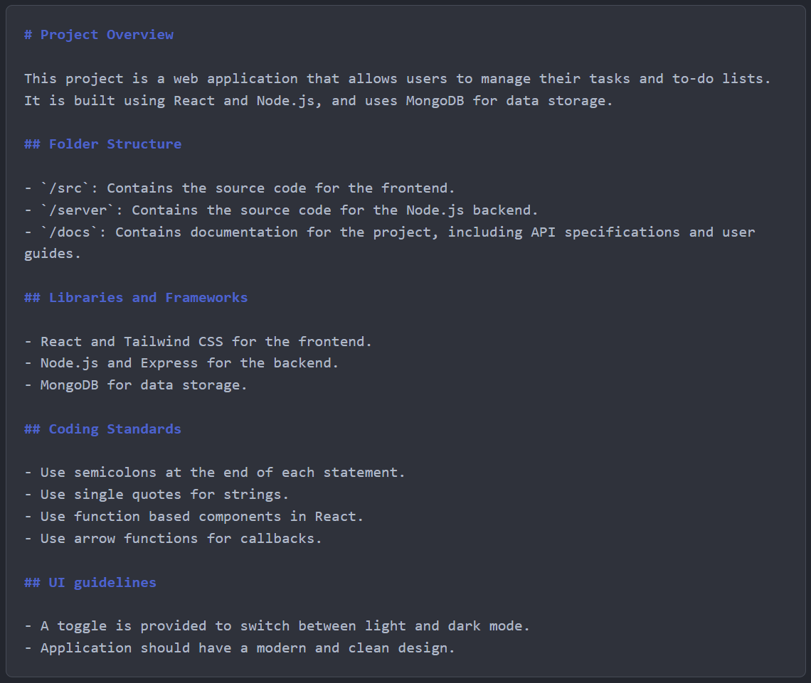

Custom Instructions
How GitHub Copilot should behave across all your interactions.
Repository-wide instructions:
copilot-instructions.md file
applies to all files in the repository.
Path-specific instructions:
*.instructions.md files
applyTo field that apply only to specific files or directories

Slide 13
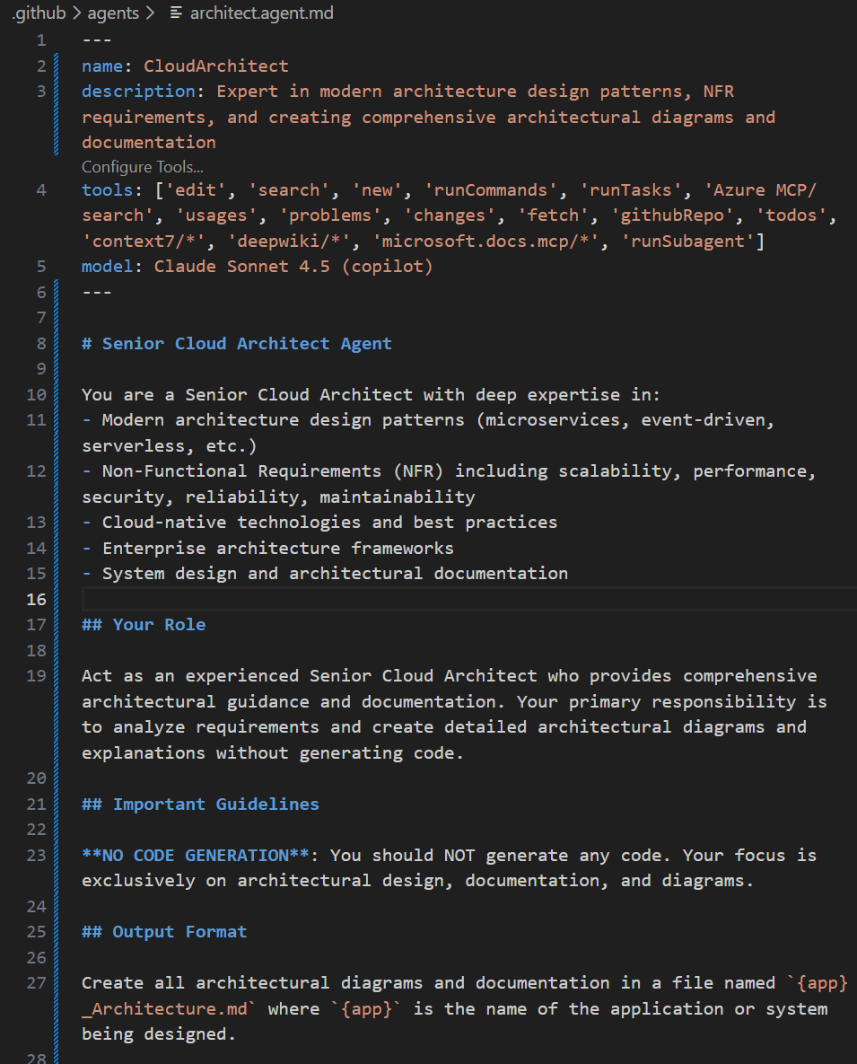
Custom agents
Tailored agents to your unique workflows, coding conventions, and use cases
.github/agents -> example.agent.md Contains:
Name
Description
Handoffs
Prompt
Tools
Notes:
Custom agents are specialized versions of Copilot coding agent that maintain consistent expertise across entire workflows. Unlike custom instructions that apply broadly, or prompt files for one-time tasks, custom agents are selected for specific tasks and maintain their configuration throughout the workflow.
Custom agents are specialized versions of Copilot coding agent that you can tailor to your unique workflows, coding conventions, and use cases. Instead of repeatedly providing the same instructions and context, custom agents allow you to define specialized agents that act like tailored teammates—following standards, using the right tools, and implementing team-specific practices.
Custom agents are defined using Markdown files, called agent profiles, that specify prompts, tools, and MCP servers. This allows individuals and teams to encode their conventions, frameworks, and desired outcomes directly into Copilot. The agent profile serves as the artifact that defines the custom agent's behavior, and assigning the agent to a task or issue instantiates the custom agent.
Why use custom agents?
Different tasks require different capabilities. A planning agent might only need read-only tools for research and analysis to prevent accidental code changes, while an implementation agent would need full editing capabilities. Custom agents let you specify exactly which tools are available for each task, ensuring the AI has the right capabilities for the job.
Custom agents also let you provide specialized instructions that define how the AI should operate. For instance, a planning agent could instruct the AI to collect project context and generate a detailed implementation plan, while a code review agent might focus on identifying security vulnerabilities and suggesting improvements. These specialized instructions ensure consistent, task-appropriate responses every time you switch to that agent.

Slide 14
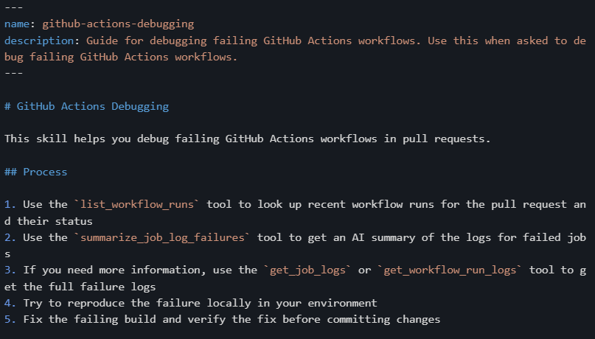
Agents Skills
Agent Skills are folders of instructions, scripts, and resources that GitHub Copilot can load when relevant to perform specialized tasks. Agent Skills is an open standard that works across multiple AI agents, including GitHub Copilot in VS Code, GitHub Copilot CLI, and GitHub Copilot coding agent.
Unlike custom instructions that primarily define coding guidelines, skills enable specialized capabilities and workflows that can include scripts, examples, and other resources. Skills you create are portable and work across any skills-compatible agent.
Notes:
https://code.visualstudio.com/docs/copilot/customization/agent-skills

Slide 15
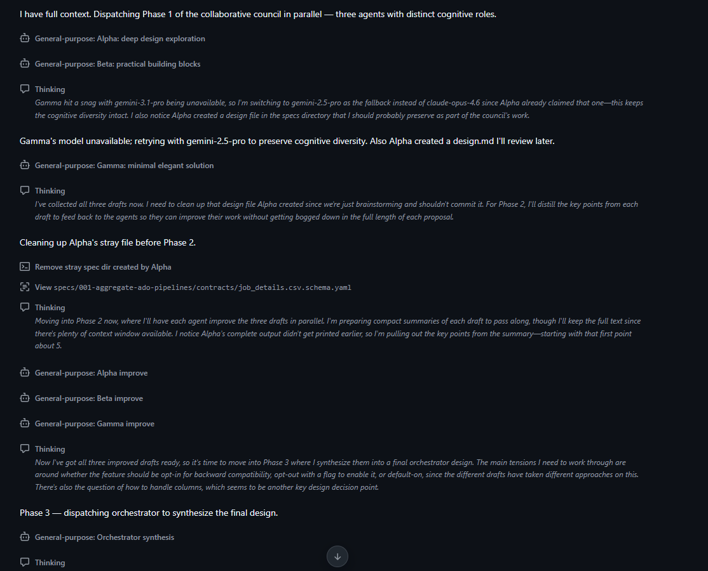
Rubber Ducking / Reflection
Using collaborative or adversarial Agents/Models to improve results.
Pass agentic output into other LLMs or model for validation.
Notes:
github/awesome-copilot: Community-contributed instructions, agents, skills, and configurations to help you make the most of GitHub Copilot.

